Slide 1
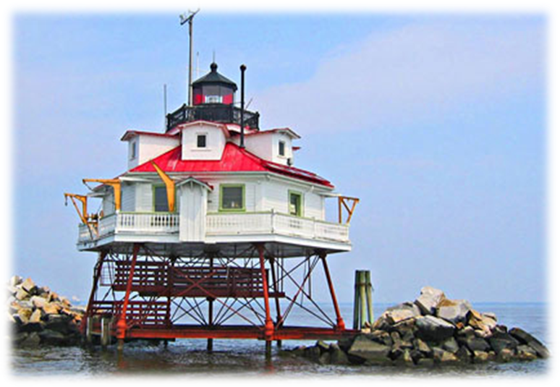
Transforming Maryland's Electric Distribution Systems
November 2018
Chairman Jason Stanek, Maryland PSC

Slide 2
Electrification in Maryland

Slide 3
Our Guiding Principles
Affordable
Reliable
Customer-centered
Environmentally Sustainable

Slide 4
Targeted Review Areas
Rate Design
Time of Use Rates
Value of Solar
Electric Vehicles
Competitive Markets & Customer Choice
Interconnection Process
Energy Storage

Slide 5
Time of Use Rates
TOU Pilots for Supply and Distribution
Price signals
Customer understanding and control of energy usage
Capitalize on AMI investments
Plans under development
Implementation
Marketing and outreach
EM&V
January 2019 – Enrollment open to ~ 4000 customers per service territory (BGE, PEPCO & DPL)
April 2019 thru March 2021 – TOU rates are effective

Slide 6
Value of Solar Study
Cost/Benefit Analysis of Solar DER in Maryland
BTM and utility scale solar
Local power distribution
Societal and economic
Locational initiatives
Maryland’s 1,500 MW Solar Cap

Slide 7
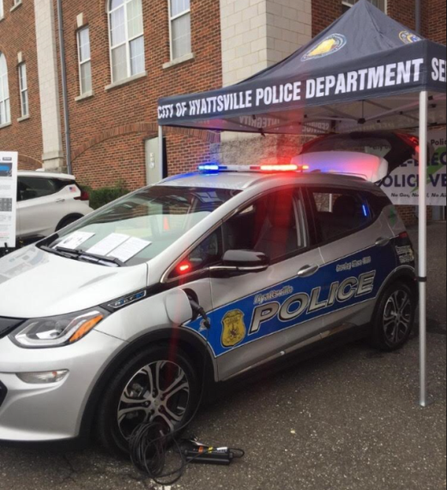
Electric Vehicles
2018 Petition for Implementation of Statewide EV Portfolio
Proposals for smart EV charging infrastructure in all IOU territories
Support Maryland’s ZEV MOU goal of 300,000 EVs by 2025
NREL study for Maryland – existing gaps in charging infrastructure

Slide 8
Competitive Markets & Customer Choice
Addressing barriers to competitive markets, including access to customer data
Retail choice suppliers & 3rd party non-supply providers
Proposed Rulemaking (RM62)
Enhancements to existing supplier regulations
Continued engagement on additional supplier developments

Slide 9
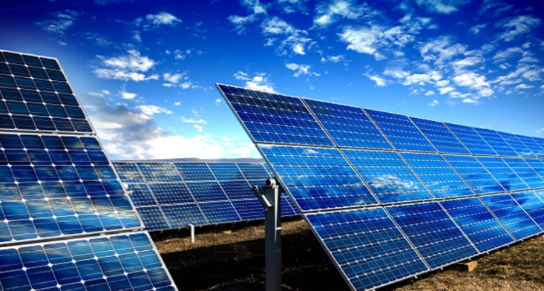
Interconnection Standards
Phase I (Rulemaking complete)
Facilitated interconnection processes for small generators
Reduced costs and increased connection certainty for developers
Phase II (Ongoing)
Integrating energy storage and smart inverters
Evaluating hosting capacity analysis reporting requirements

Slide 10
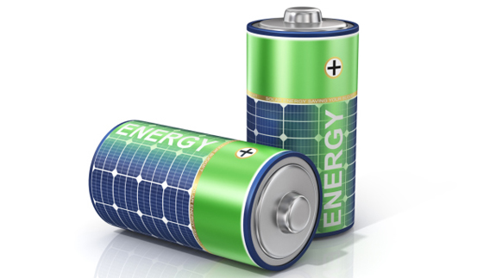
Energy Storage
Department of Natural Resources, Power Plant Research Program (PPRP) Study – Dec. 2018
Legal and policy implications of storage ownership by utilities and others in deregulated markets
Stakeholders considering various ownership and project models

